Slide 1
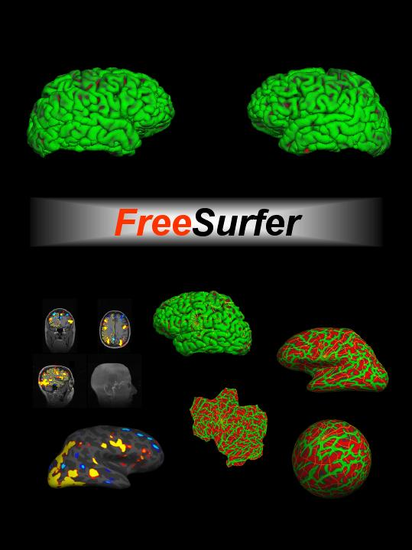
Working with FreeSurfer ROIs surfer.nmr.mgh.harvard.edu

Slide 2
Outline
FreeSurfer ROI Terminology
ROI Statistics Files
ROI Studies
  Volumetric/Area
  “Intensity”
FreeSurfer ROI Atlases
Atlas Creation and Application
Notes:
ROI = Region of Interest; Talk is going to cover the two ways to analyze an ROI, etc.

Slide 3
FreeSurfer ROI Terminology
ROI = Region Of Interest
which can include:
  Segmentation (i.e. subcortical)
  Parcellation/Annotation
  Clusters, Masks (from sig.mgh, fMRI)
  Label you created

Slide 4
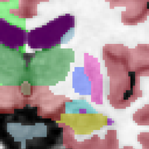
Segmentation
Volume or surface (usually volume)
Volume-style format (eg, mgz, nii, etc)
Each voxel/vertex has one index (number ID)
Index List found in color lookup table (LUT)
  $FREESUFER_HOME/FreeSurferColorLUT.txt
  17 Left-Hippocampus 220 216 20 0
  Index = 17
  Name = Left-Hippocampus
  Red=220, Green=216, Blue=20 (out of 255)
  alpha = 0 (not really used)
aseg.mgz, aparc+aseg.mgz, aparc.a2005+aseg.mgz, wmparc.mgz
Notes:
The index ID is just to keep track of all the different structures. Each must be a unique color.

Slide 5
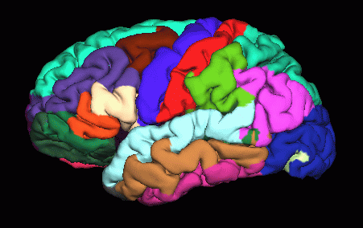
Parcellation/Annotation
Surface ONLY
Annotation format (something.annot)
Each vertex has only one label/index
Index List also found in color lookup table (LUT)
  $FREESUFER_HOME/FreeSurferColorLUT.txt
?h.aparc.annot, ?h.aparc.a2005.annot

Slide 6
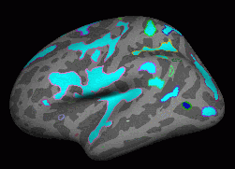
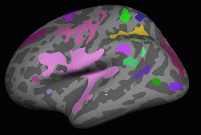
Clusters
Clusters (significance map; functional activation)
  One output of mri_volcluster and mri_surfcluster
  are segmentations or annotation (volume vs. surface)
  Each cluster gets its own number/index
  Masks (another type of segmentation)
    Binary: 0, 1
    Can be derived by thresholding statistical maps
Thresholded Activity
Activation Clusters
Notes:
Clusters are blobs seen in signifcance maps and funtional activation. These are commands in freesurfer that create these clusters. Mask out = to see only a certain area. Similar to clusters just created differently.

Slide 7
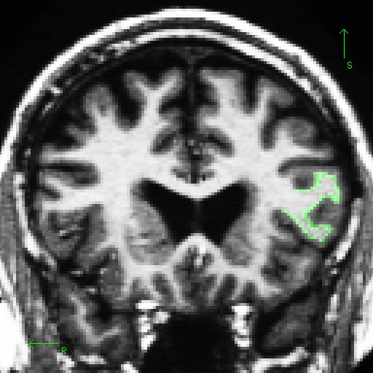
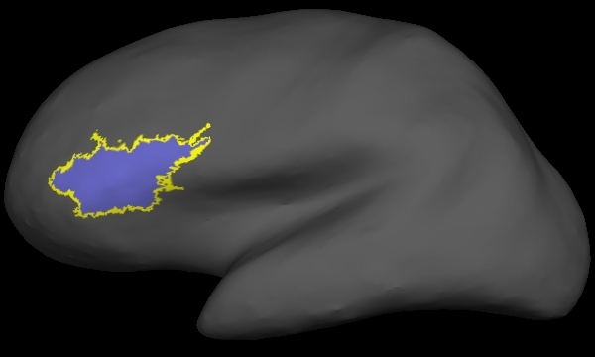
Label File
In Volume
On Surface
  Easy to draw
  Use ‘Select Voxels’ Tool in tkmedit
  Simple text format

Slide 8
Creating Label Files
Drawing tools:
  tkmedit
  tksurfer
  QDEC
Deriving from other data
  mris_annotation2label: cortical parcellation broken into units
  mri_volcluster: a volume made into a cluster
  mri_surfcluster: a surface made into a cluster
  mri_cor2label: a volume/segmentation made into a label
  mri_label2label: label from one space mapped to another
Notes:
annotation2label = aparc areas made into label format; volcluster = a volume made into a cluster; surf cluster = a surface made into a cluster; cor2label = a volume/segmentation made into a label; label2label = map a label from one subject to another

Slide 9
Label File
Surface or Volume
Simple Text format (usually something.label)
  Each row as 5 Columns: Vertex X Y Z Statistic
    Vertex – 0-based vertex number
      only applies to surfaces, ignored for volumes
    XYZ – coordinates (in one of many systems)
    Statistic – often ignored
Eg, lh.cortex.label
#label , from subject fsaverage
4
88 -42.261 -81.724 -13.242 0.000000
445 -28.781 -85.827 -16.289 0.000000
446 -39.862 -74.518 -14.432 0.000000
616 -42.856 -74.239 -5.499 0.000000
      Indicates 4 “points” in label
Notes:
points as in how many vertex points are included within the label

Slide 10
ROI Statistic Files
Simple text files
Volume and Surface ROIs (different formats)
Automatically generated: aseg.stats, lh.aparc.stats, etc
Combine multiple subjects into one table with asegstats2table or aparcstats2table (then import into excel).
You can generate your own with either
  mri_segstats (volume)
  mris_anatomical_stats (surface)

Slide 11
Segmentation Stats File
Index SegId NVoxels Volume_mm3 StructName Mean StdDev Min Max Range
1 4 5855 5855.0 Left-Lateral-Ventricle 37.7920 10.9705 20.0000 88.0000 68.0000
2 5 245 245.0 Left-Inf-Lat-Vent 56.4091 9.5906 26.0000 79.0000 53.0000
3 7 16357 16357.0 Left-Cerebellum-White-Matter 91.2850 4.8989 49.0000 106.0000 57.0000
4 8 60367 60367.0 Left-Cerebellum-Cortex 76.3620 9.5724 26.0000 135.0000 109.0000
5 10 7460 7460.0 Left-Thalamus-Proper 91.3778 7.4668 43.0000 108.0000 65.0000
6 11 3133 3133.0 Left-Caudate 78.5801 8.2886 42.0000 107.0000 65.0000
7 12 5521 5521.0 Left-Putamen 86.9680 5.5752 66.0000 106.0000 40.0000
8 13 1816 1816.0 Left-Pallidum 97.7162 3.4302 79.0000 106.0000 27.0000
9 14 852 852.0 3rd-Ventricle 41.9007 11.8230 22.0000 69.0000 47.0000
10 15 1820 1820.0 4th-Ventricle 39.7053 10.6407 20.0000 76.0000 56.0000
11 16 25647 25647.0 Brain-Stem 85.2103 8.2819 38.0000 106.0000 68.0000
12 17 4467 4467.0 Left-Hippocampus 77.6346 7.5845 45.0000 107.0000 62.0000
13 18 1668 1668.0 Left-Amygdala 74.5104 5.8320 50.0000 94.0000 44.0000
14 24 1595 1595.0 CSF 52.1348 11.6113 29.0000 87.0000 58.0000
Index: nth Segmentation in stats file
SegId: index into lookup table
NVoxels: number of Voxels/Vertices in segmentation
StructName: Name of structure from LUT
Mean/StdDev/Min/Max/Range: intensity across ROI
Eg: aseg.stats, wmparc.stats (in subject/stats)
created by mri_segstats
Notes:
Volume stats and Intensity stats

Slide 12
Cortical, Gray, White, Intracranial Volumes
Also in aseg.stats header:
# Measure lhCortex, lhCortexVol, Left hemisphere cortical gray matter volume, 192176.447567, mm^3
# Measure rhCortex, rhCortexVol, Right hemisphere cortical gray matter volume, 194153.9526, mm^3
# Measure Cortex, CortexVol, Total cortical gray matter volume, 386330.400185, mm^3
# Measure lhCorticalWhiteMatter, lhCorticalWhiteMatterVol, Left hemisphere cortical white matter volume, 217372.890625, mm^3
# Measure rhCorticalWhiteMatter, rhCorticalWhiteMatterVol, Right hemisphere cortical white matter volume, 219048.187500, mm^3
# Measure CorticalWhiteMatter, CorticalWhiteMatterVol, Total cortical white matter volume, 436421.078125, mm^3
# Measure SubCortGray, SubCortGrayVol, Subcortical gray matter volume, 182006.000000, mm^3
# Measure TotalGray, TotalGrayVol, Total gray matter volume, 568336.400185, mm^3
# Measure SupraTentorial, SupraTentorialVol, Supratentorial volume, 939646.861571, mm^3
# Measure IntraCranialVol, ICV, Intracranial Volume, 1495162.656130, mm^3
lhCortex, rhCortex, Cortex – surface-based measure of cortical gray matter volume
lhCorticalWhiteMater, … – surface-based measure of cortical white matter volume
SubCortGray – volume-based measure of subcortical gray matter
TotalGray – Cortex + Subcortical gray
IntraCrainialVol – estimated Total Intracranial vol (eTIV)
http://surfer.nmr.mgh.harvard.edu/fswiki/eTIV
Notes:
define hyperintensities

Slide 13
Getting Stats into Table Format
asegstats2table --subjects 001 002 003 004 005 006 007 --meas volume --tablefile asegstats.txt
cd $SUBJECTS_DIR to find asegstats.txt
From Excel, File > Open, search for asegstats.txt (make sure viewing all file types) > Choose Delimited, Space, and Finish

Slide 14
Parcellation Stats File
StructName NumVert SurfArea GrayVol ThickAvg ThickStd MeanCurv GausCurv FoldInd CurvInd
unknown 10863 7151 13207 1.776 1.629 0.121 0.107 383 50.8
bankssts 1222 830 2290 2.711 0.559 0.112 0.027 10 1.3
caudalanteriorcingulate 830 585 1459 2.474 0.569 0.128 0.020 10 0.7
caudalmiddlefrontal 2509 1658 4979 2.653 0.567 0.125 0.035 27 3.5
corpuscallosum 2124 1340 569 0.489 0.631 0.151 0.110 87 8.0
cuneus 2737 1706 3086 1.741 0.509 0.162 0.065 52 8.0
entorhinal 495 330 1685 3.150 0.753 0.149 0.187 15 1.5
fusiform 3878 2638 7887 2.627 0.724 0.137 0.046 57 6.7
StructName: Name of structure/ROI
NumVert: number of vertices in ROI
SurfArea: Surface area in mm2
GrayVol: volume of gray matter (surface-based)
ThickAvg/ThickStd – average and stddev of thickness in ROI
MeanCurv – mean curvature
GausCurv – mean gaussian curvature
FoldInd – folding index
CurvInd – curvature index
Eg, lh.aparc.stats, lh.a2005s.aparc.stats
created by mris_anatomical_stats

Slide 15
Getting Stats into Table Format
Gray matter volume of structure: “GrayVol”
aparcstats2table --subjects 001 002 003 --hemi rh
--meas volume --tablefile aparc_rh_vol_stats.txt
Average Thickness of structure: “ThickAvg”
aparcstats2table --subjects 001 002 003 --hemi rh
--meas thickness --tablefile aparc_rh_thick_stats.txt
Surface Area of structure: “SurfArea”
aparcstats2table --subjects 001 002 003 --hemi rh --meas area --tablefile aparc_rh_area_stats.txt
*Repeat above for lh; .txt files in SUBJECTS_DIR

Slide 16
GLM Analysis on Stats Files
mri_glmfit (used for image-based group analysis)
Use “--table stats.table” instead of “--y” to specify the input
Eg, “mri_glmfit --table aparc_rh_vol_stats.txt …”
The rest of the command-line is the same as you would use for a group study (eg, FSGD file and contrasts).
Output is text file sig.table.dat that lists the significances (-log10(p)) for each ROI and contrast.

Slide 17
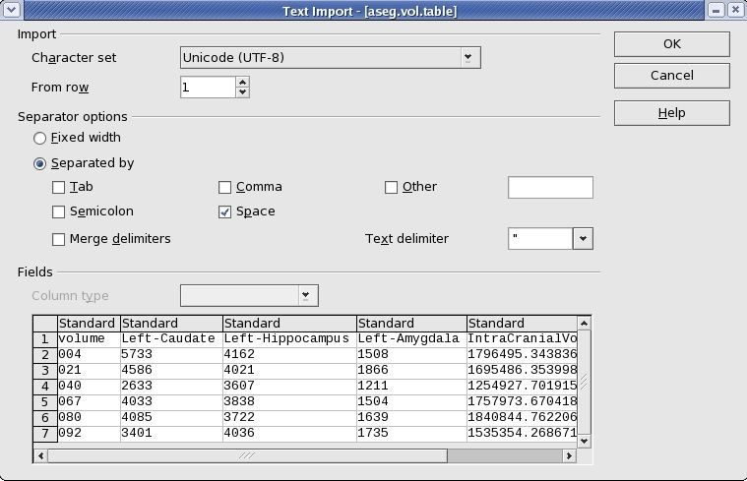
Exporting Stats Files
Choose Delimited by spaces
Convert stats files from a group of subjects into a single table that can be loaded into a spreadsheet.
stats text files in SUBJECTS_DIR

Slide 18
ROI Studies
Volumetric/Area
  size; number of units that make up the ROI
“Intensity”
  average values at point measures (voxels or vertices) that make up the ROI
Notes:
ROI = Region of Interest; Talk is going to cover the two ways to analyze an ROI, etc.

Slide 19
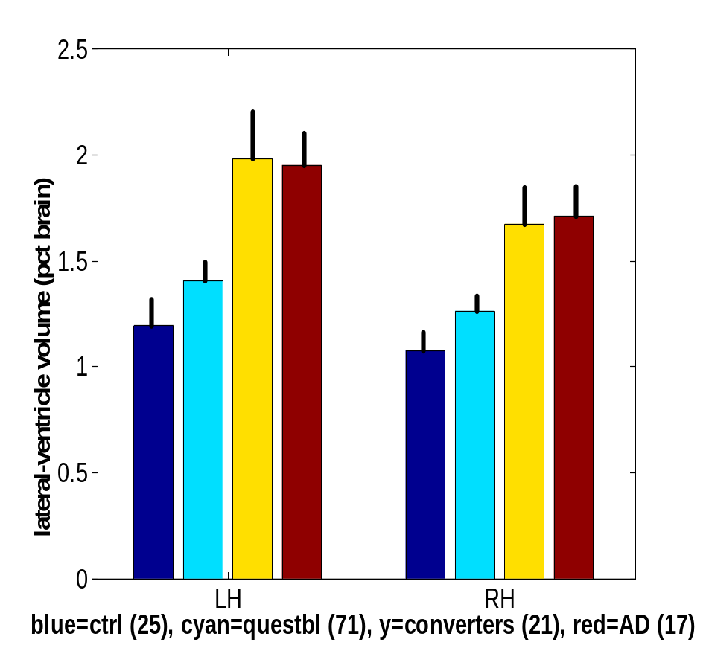
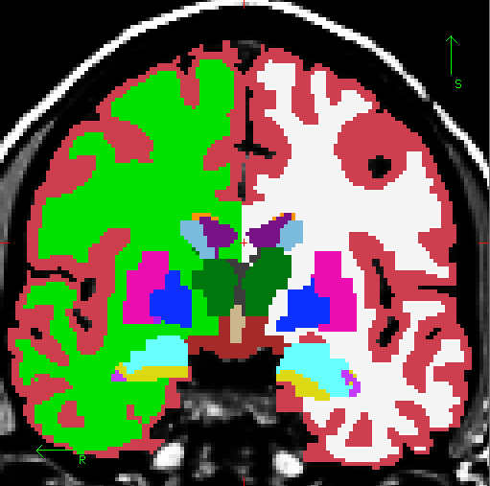
ROI Volume Study
Volume of Lateral Ventricle
Lateral Ventricle
Control
Questbl
Converters
AD
Data courtesy of Drs Marilyn Albert & Ron Killiany
Notes:
An example of a volume study of the lateral ventricle looking at volume differences between patients with Alzheimer’s Disease and Controls. A volume study is in mm^3 and is looking at how many voxels are in an ROI.

Slide 20
ROI Mean “Intensity” Analysis
Average vertex/voxel values or “point measures” over ROI
  MR Intensity (T1)
  Thickness, Sulcal Depth
Multimodal
  fMRI intensity
  FA values (diffusion data)
Notes:
Vertex value will have intensity info from T1, Thickness, sulcal depth, etc. Since the way we derive ROIs is not by a map only (it is highly individualized to each subject’s anatomy) this allows you to take the mean vertex info from a region and get an accurate measure you can compare across subjects. i.e. average intensity over hippocampus

Slide 21
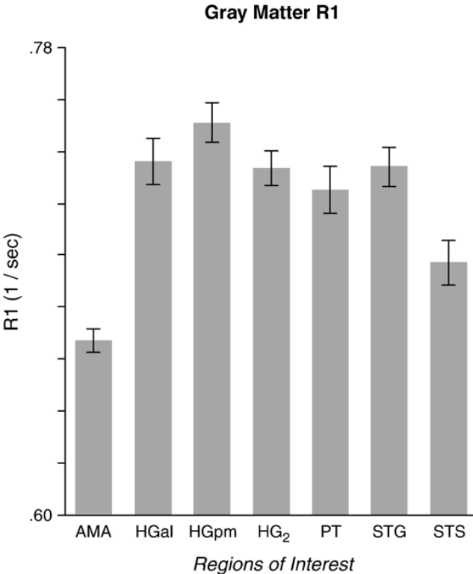
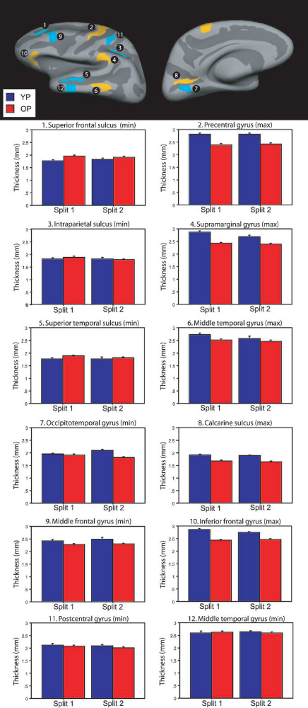
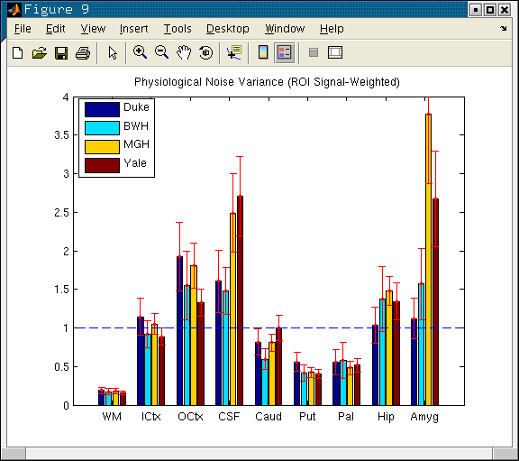
ROI Mean “Intensity” Studies
Thickness
Salat, et al, 2004.
Physiological Noise
fMRI
Sigalovsky, et al, 2006
R1 Intensity
Greve, et al, 2008.
Notes:
Left: R1 intensity value comparisons across gray matter regions (R1 is inverse of T1); Top right: Thickness of specific regions compared between young participants and old participants. Bottom right: Comparisons of physiological noise in fmri studies by point measure.

Slide 22
Volume and Surface Atlases

Slide 23
Volumetric Segmentation (aseg)
Cortex
Lateral Ventricle
White Matter
Not Shown:
Nucleus Accumbens
Cerebellum
Thalamus
Caudate
Putamen
Pallidum
Amygdala
Hippocampus
Whole Brain Segmentation: Automated Labeling of Neuroanatomical Structures in the Human Brain, Fischl, B., D.H. Salat, E. Busa, M. Albert, M. Dieterich, C. Haselgrove, A. van der Kouwe, R. Killiany, D. Kennedy, S. Klaveness, A. Montillo, N. Makris, B. Rosen, and A.M. Dale, (2002). Neuron, 33:341-355.

Slide 24
Volumetric Segmentation Atlas Description
39 Subjects
14 Male, 25 Female
Ages 18-87
  Young (18-22): 10
  Mid (40-60): 10
  Old Healthy (69+): 8
  Old Alzheimer's (68+): 11
Siemens 1.5T Vision (Wash U)
Whole Brain Segmentation: Automated Labeling of Neuroanatomical Structures in the Human Brain, Fischl, B., D.H. Salat, E. Busa, M. Albert, M. Dieterich, C. Haselgrove, A. van der Kouwe, R. Killiany, D. Kennedy, S. Klaveness, A. Montillo, N. Makris, B. Rosen, and A.M. Dale, (2002). Neuron, 33:341-355.

Slide 25
Automatic Surface Parcellation:
Desikan/Killiany Atlas
Precentral Gyrus
Postcentral Gyrus
Superior Temporal Gyrus
An automated labeling system for subdividing the human cerebral cortex on MRI scans into gyral based regions of interest, Desikan, R.S., F. Segonne, B. Fischl, B.T. Quinn, B.C. Dickerson, D. Blacker, R.L. Buckner, A.M. Dale, R.P. Maguire, B.T. Hyman, M.S. Albert, and R.J. Killiany, (2006). NeuroImage 31(3):968-80.

Slide 26
Desikan/Killiany Atlas
40 Subjects
14 Male, 26 Female
Ages 18-87
30 Nondemented
10 Demented
Siemens 1.5T Vision (Wash U)
An automated labeling system for subdividing the human cerebral cortex on MRI scans into gyral based regions of interest, Desikan, R.S., F. Segonne, B. Fischl, B.T. Quinn, B.C. Dickerson, D. Blacker, R.L. Buckner, A.M. Dale, R.P. Maguire, B.T. Hyman, M.S. Albert, and R.J. Killiany, (2006). NeuroImage 31(3):968-80.

Slide 27
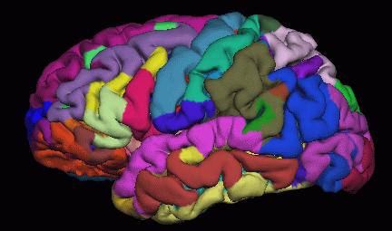
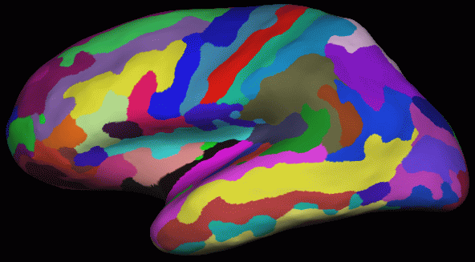
Automatic Surface Parcellation:
Destrieux Atlas
Automatically Parcellating the Human Cerebral Cortex, Fischl, B., A. van der Kouwe, C. Destrieux, E. Halgren, F. Segonne, D. Salat, E. Busa, L. Seidman, J. Goldstein, D. Kennedy, V. Caviness, N. Makris, B. Rosen, and A.M. Dale, (2004). Cerebral Cortex, 14:11-22.
Notes:
Some subjects don’t have all these areas; reliability goes down

Slide 28
Automatic Surface Parcellation:
Destrieux Atlas
58 Parcellation Units
12 Subjects
Automatically Parcellating the Human Cerebral Cortex, Fischl, B., A. van der Kouwe, C. Destrieux, E. Halgren, F. Segonne, D. Salat, E. Busa, L. Seidman, J. Goldstein, D. Kennedy, V. Caviness, N. Makris, B. Rosen, and A.M. Dale, (2004). Cerebral Cortex, 14:11-22.

Slide 29
ROI Atlas Creation
Hand label N data sets
  Volumetric: CMA
  Surface Based:
    Desikan/Killiany
    Destrieux
Map labels to common coordinate system
Probabilistic Atlas
  Probability of a label at a vertex/voxel
    Maximum Likelihood (ML) Atlas Labels
  Curvature/Intensity means and stddevs
  Neighborhood relationships
Notes:
How did we come up with these atlases that have the ROIs? CMA = Center for Morphemetric Analysis. We are creating a probabilistic Atlas based on this information.

Slide 30
Automatic Labeling
Transform ML labels to individual subject*
Adjust boundaries based on
  Curvature/Intensity statistics
  Neighborhood relationships
Result: labels are customized to each individual.
You can create your own atlases**
* Formally, we compute maximum a posteriori estimate of the labels given the input data
** Time consuming; first check if necessary
Notes:
from atlas get prior information that help us decide how to do our images and from there fine tune

Slide 31
Validation -- Jackknife
Hand label N Data Sets
Create atlas from (N-1) Data Sets
Automatically label the left out Data Set
Compare to Hand-Labeled
Repeat, Leaving out a different data set each time
Notes:
compute a dice coefficient for each N to see how much the automatic labeled and hand labeled overlap

Slide 32
Derived ROIs
Combined Volume-Surface segmentation
  aparc+aseg.mgz, a2005.aparc+aseg.mgz
White Matter Parcellation
  wmparc.mgz
Notes:
Derived as in we combine different ROIs (aseg + aparc) or like wmparc where it’s just based on closest gray matter voxel

Slide 33
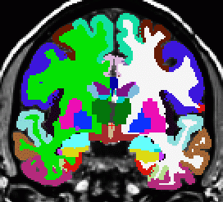
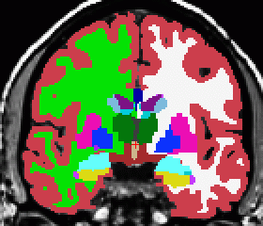
Merged Cortical + Subcortical
aparc
aparc+aseg
Use ROI volume as computed from aparc (more accurate)
aseg

Slide 34
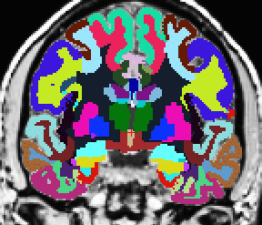
Gyral White Matter Segmentation
+
+
aparc+aseg
wmparc
Nearest Cortical Label
to point in White Matter

Slide 35
Summary
Atlases: Probabilistic
ROIs are Individualized
Volume and Surface ROIs come in many different types
Measures for Studies
  Volume, Area
  Intensity, Thickness, Curvature
Multimodal Applications

Slide 36
Tutorial
Simultaneously load:
  aparc+aseg.mgz (tkmedit)
  aparc.annot (tksurfer)
  FreeSurferColorLUT.txt
View Individual Stats Files
Group Table
  Create
  Load into spreadsheet

Slide 37
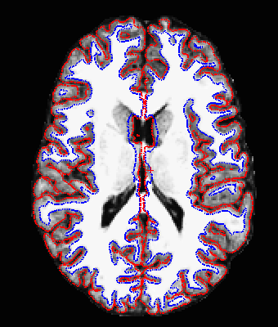
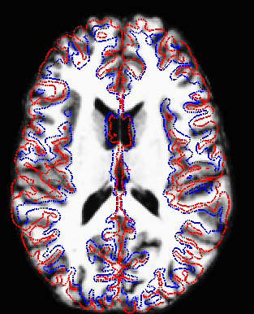
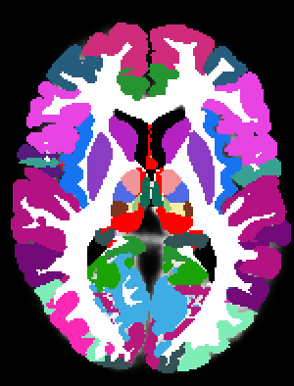
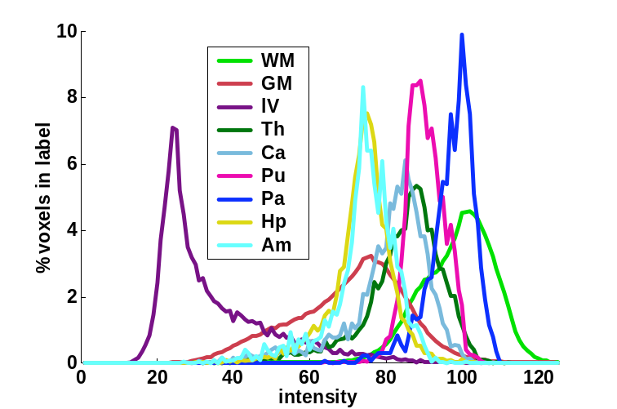
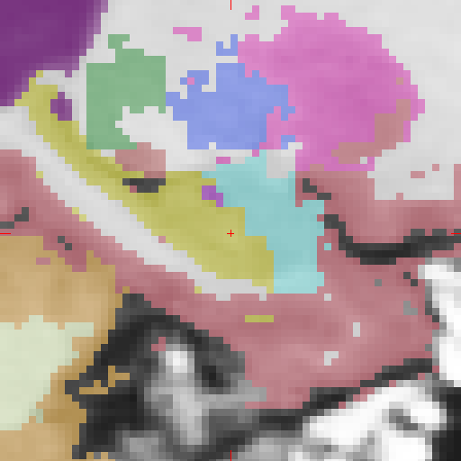
Why we use atlas + intensity + spatial location + geometric info + other info…
Problems with Affine (12 DOF) Registration
ROIs need to be individualized.
Why not just register to an ROI Atlas?
12 DOF
(Affine)
ICBM Atlas
Markov Random Field: Motivation
Can’t segment on intensity alone
What is the probability that cortical gray matter occurs inferior to hippocampus?
Notes:
Since can’t segment on intensity alone, can give information about location

Slide 38

Segmentation: MRF
Preliminary Segmentation

Slide 39
Segmentation: MRF
Final Segmentation

